Slide 1
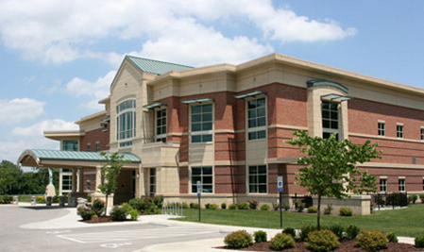
Cool Tools How to Use the Midwest Genealogy Center

Slide 2
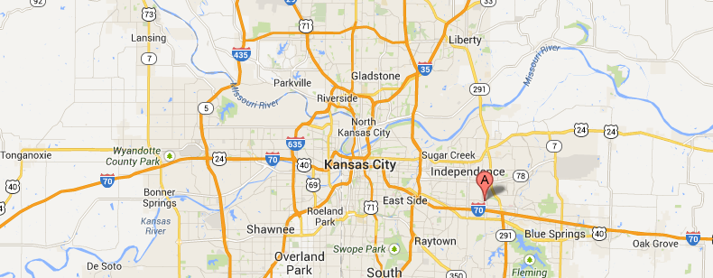
Located….
Just East of Kansas City in Independence, Missouri
I-70 and Lee’s Summit Road

Slide 3
Midwest Genealogy Center
Largest Public Genealogy Library in US
52,000 square feet
104,000 books, almost 60,000 microform
Kansas City Based
Part of Mid-Continent Public Library System
Supported by local tax revenue
This facility opened June 2008
National / International in Scope
Open on Sundays

Slide 4
In Today’s Presentation…
Microform
Film
Fiche
Books
Best References
Maps
Periodicals
Classes
Library Card
Onsite PCs
Subscription Websites
Library’s Website
Other Cool Websites
Finding Aids
Use the Card Catalog
WorldCAT

Slide 5
Library card

Slide 6

Library Card
Free if –
You live in the area
Have another local library card
Fee if –
Outside the 17-county metro area
Research card - $20/6 months
Obtained only at Midwest Genealogy Center

Slide 7
Library Card
Your ticket to
Checking out books
Inter-library loan to MGC
Access to online databases
Access to WorldCAT
Use of the PCs onsite
You don’t need it to use the catalog, online forms, finding aids

Slide 8
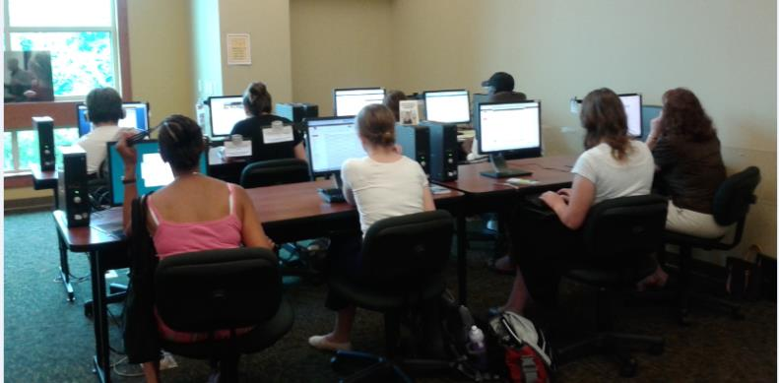
Onsite Computers

Slide 9

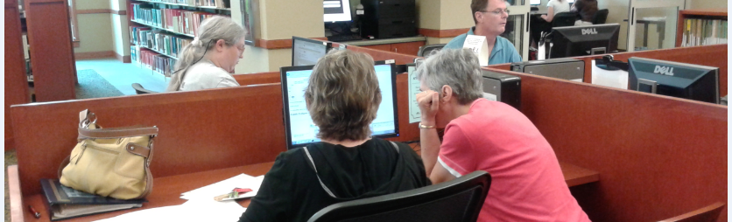
Use the Center’s PCs
Free access with Library Card
1 hour limit; but can reset timer for another hour @ 15 minute increments
Access to Subscription Databases
www.fold3.com (formerly Footnote)
www.ancestry.com (Library Edition)
Access to Other Databases

Slide 10
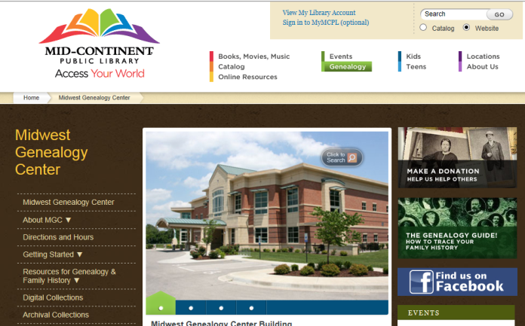
The Website

Slide 11
The Website
Your Ticket to..
The Card Catalog
WorldCAT
Finding Aids
And other cool websites

Slide 12

Card Catalog
Free. Accessible from home.
No need for library card.
Search Tips
Search for any books, some film
Look for unusual Dewey Decimal Numbers in results (film, electronic, family histories, maps)
UMI – microfiche indexed in Card Catalog
Search using county name
Sedgwick County Kansas
Polk County Iowa

Slide 13
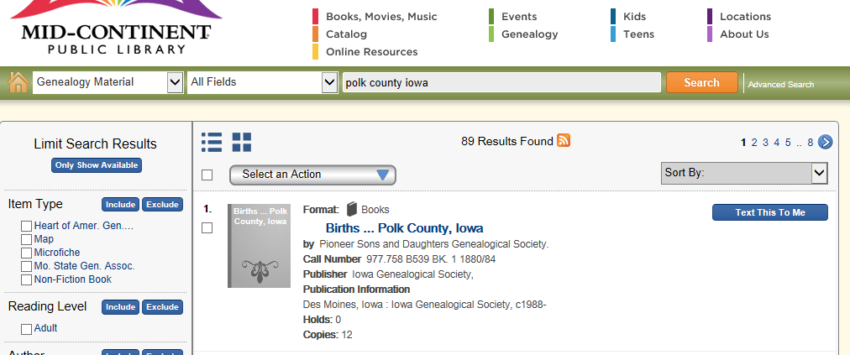
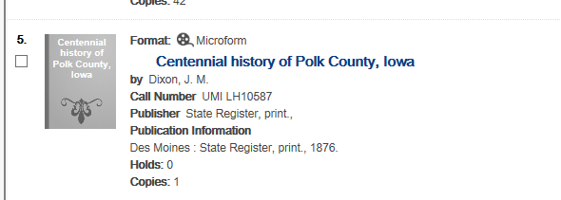
Card Catalog

Slide 14
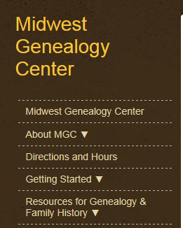
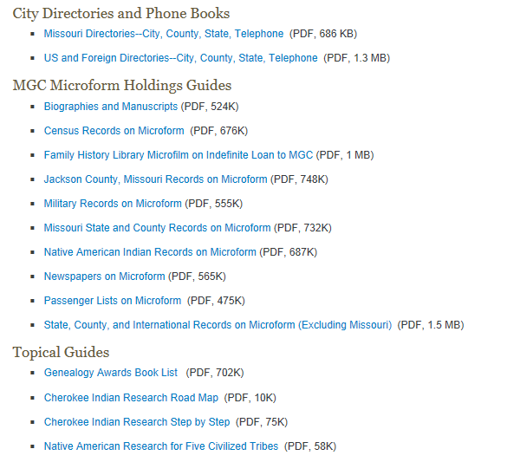
Finding Aids
Lists of Holdings
Research Strategies
Do not need library card

Slide 15

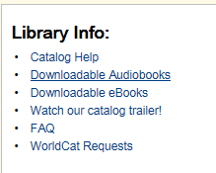
WorldCAT
World Catalog
Accessible from home
A Card Catalog for 10,000 libraries worldwide
Free or nominal fee for interlibrary loan
Identifies libraries by closest local first
Need library card

Slide 16
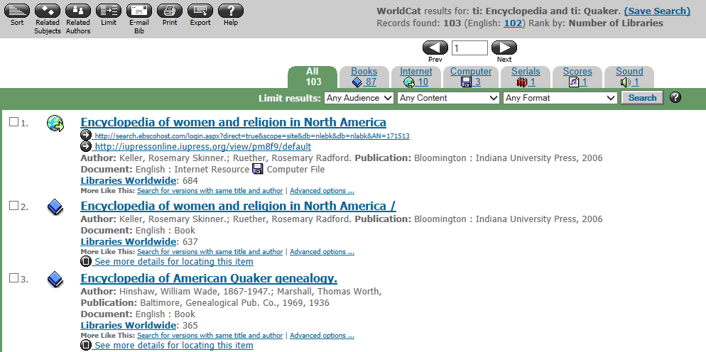
WorldCAT

Slide 17

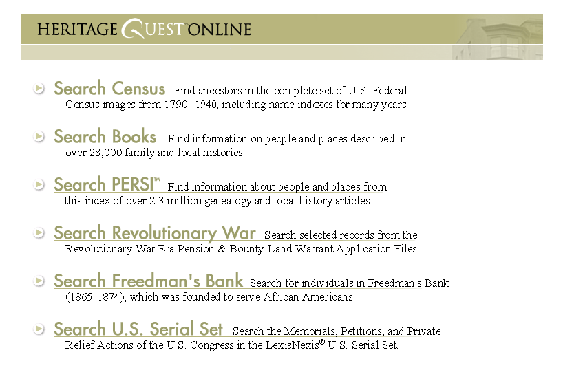
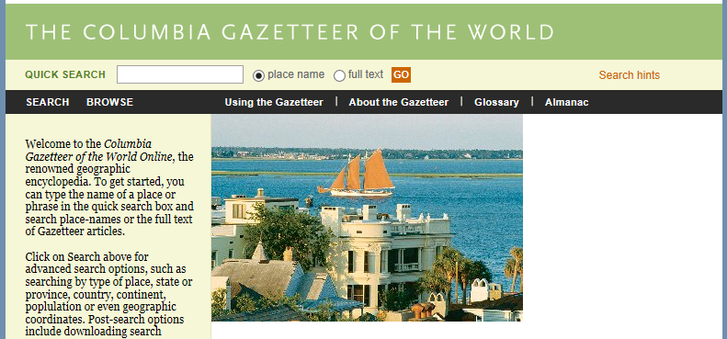
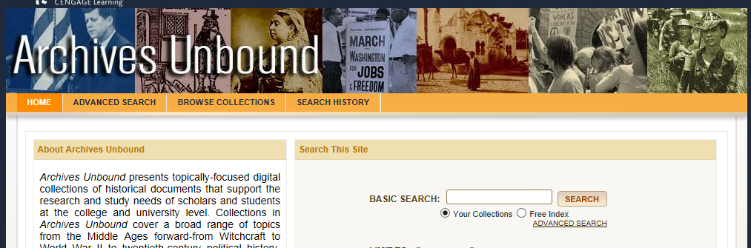
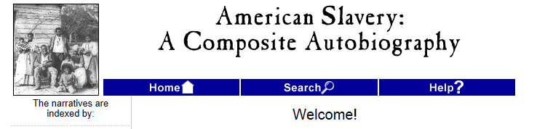
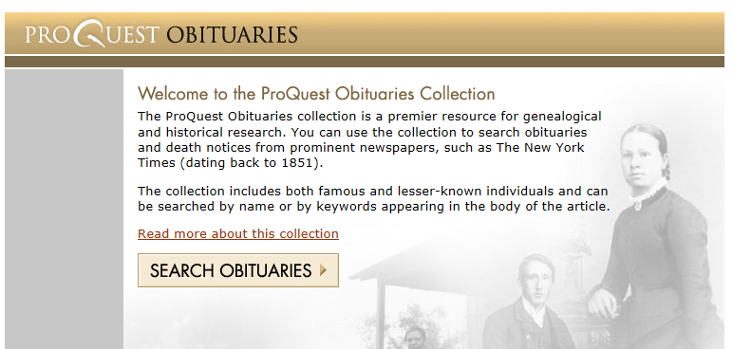
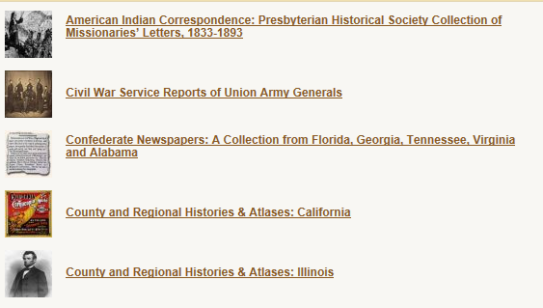
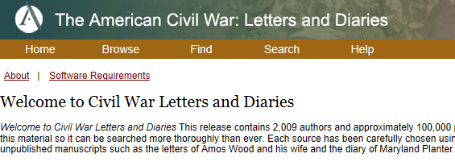
Access More Cool Websites
Columbia Gazetteer – find locations
Facts on File – timelines; histories
Heritage Quest - US Census & more
ProQuest Obituaries
NewsBank - Newspapers
Many more.
Need library card

Slide 18
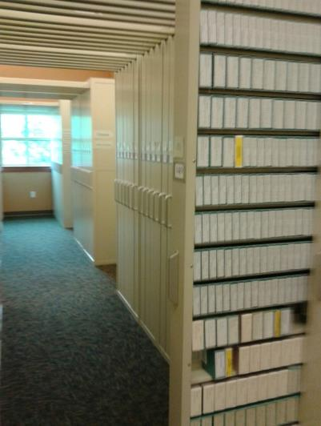
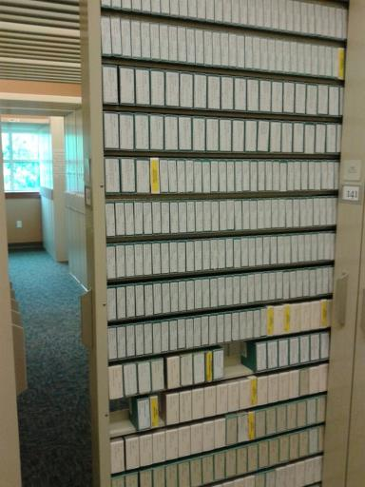
microfilm

Slide 19

Microfilm
Pre-20th Century Military
Passenger Records
Local Newspapers
- KC Star, Independence Examiner, St. Joe
Biographies & Manuscripts
Colonial era
US Censuses (1790-1930)
US County Records
Birth, marriage, death, land, probate
City Directories

Slide 20

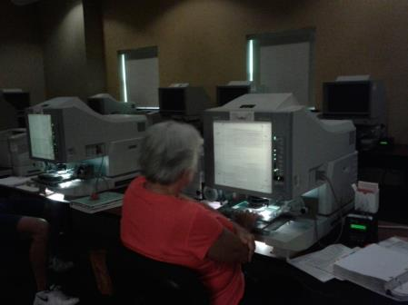
Microfilm
30 Electronic Reader/Printers
Handle microfiche & microfilm
Copy Cards Free @ Circulation Desk
Use Copy Cards (10¢/copy)
Do not replace film on shelves

Slide 21
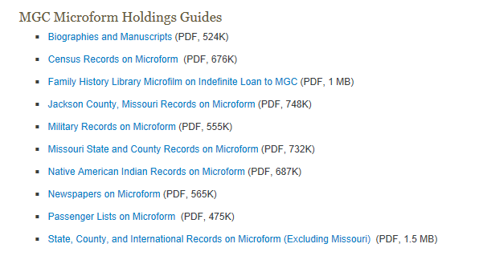
Microfilm
NOT indexed in Card Catalog (except UMI)
Finding aids in print; on website

Slide 22
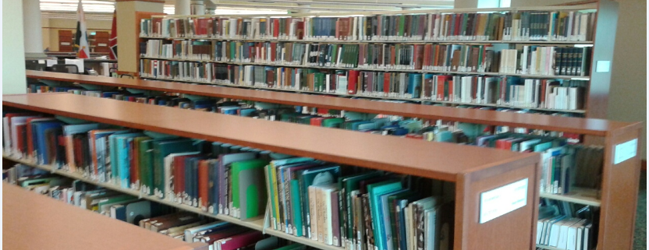
Books

Slide 23
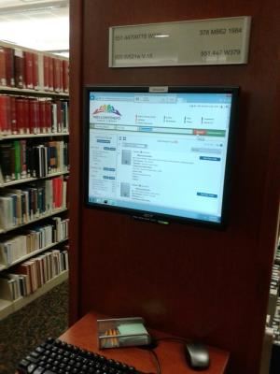
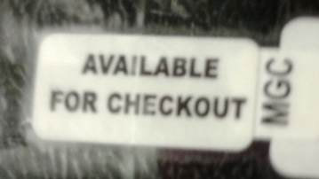

Books
National / International in scope
Handy Tips
PC Monitors w/ Catalog Upstairs
Baskets for your use
Don’t reshelf the books
Dewey Decimal System
Many Available for Checkout

Slide 24
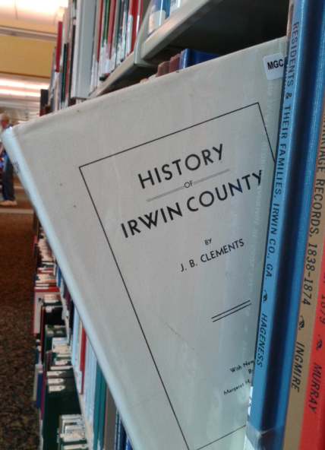
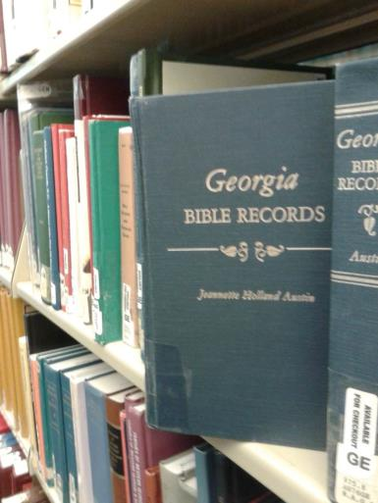
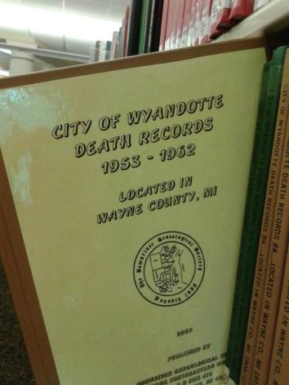
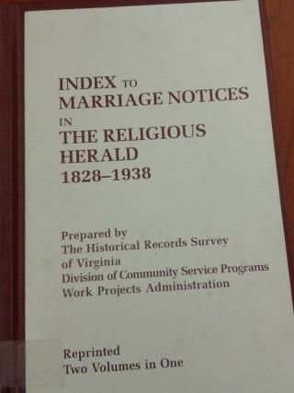
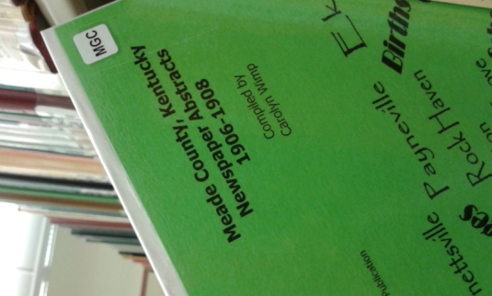

Books
Genealogies
Local Histories
Military
Birth, Marriage, Death Records
Cemetery Records
Newspaper Abstracts
Maps
Yearbooks

Slide 25
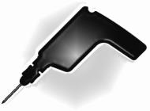
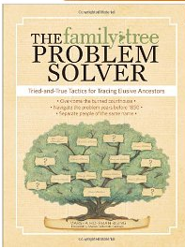
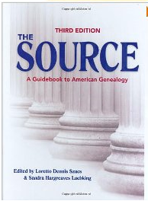
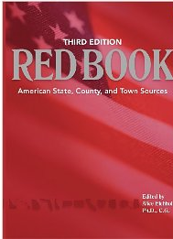
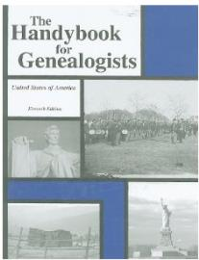
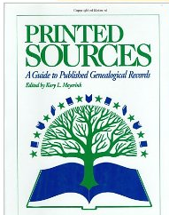
Best Reference Sources
The Source – how to do anything in genealogy
The Red Book – where to find anything in genealogy
The Handy Book – where to find anything
Printed Sources – the best guide to non-original sources

Slide 26
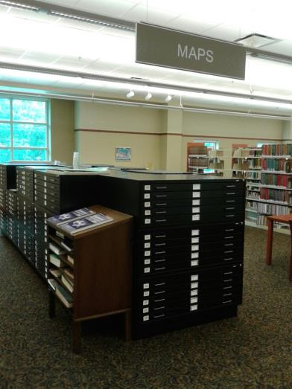
MAPS

Slide 27

Maps
Flat Maps
Bound Maps
Sanborn Fire Maps - Online
Finding
In Card Catalog
Dewey Decimal System
Scope
International to local
Current to historic
Atlas, topographic
Oversized Copier - 10¢

Slide 28
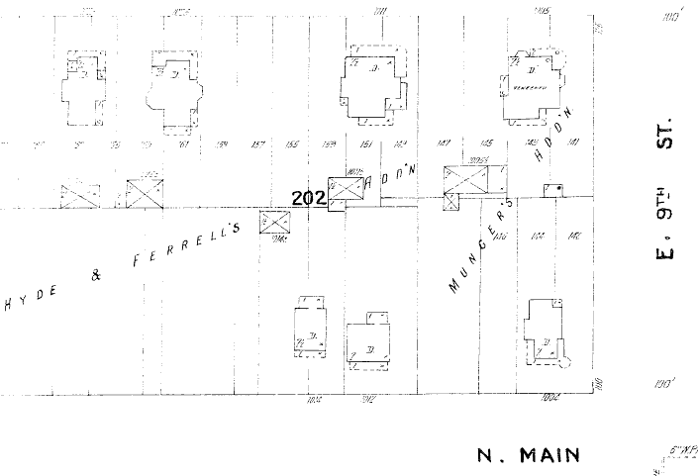
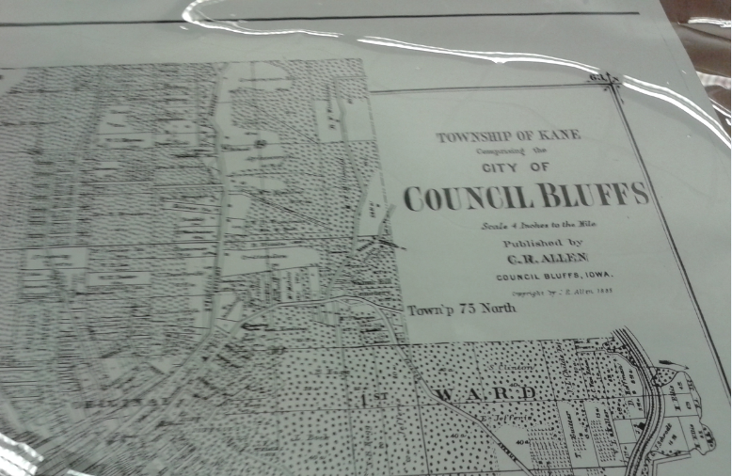
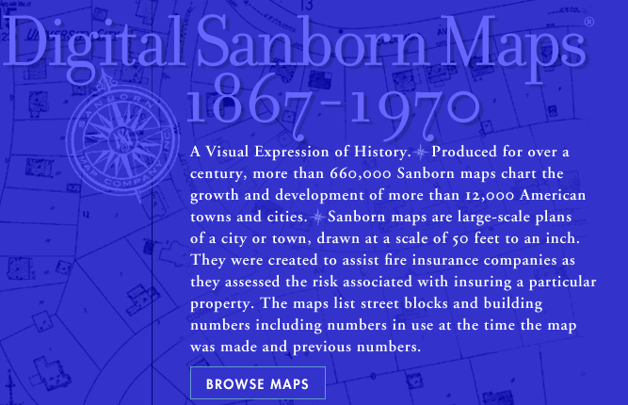
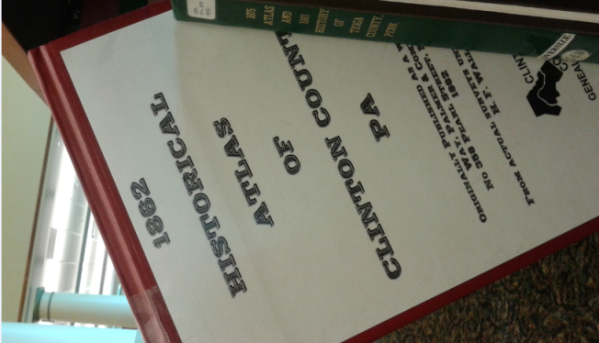
Maps

Slide 29
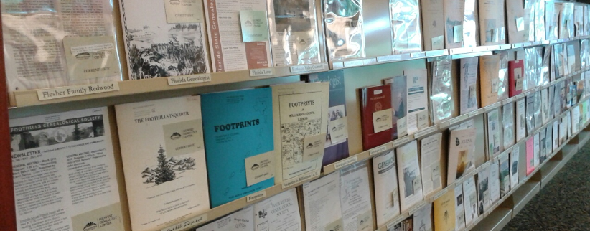
Periodicals

Slide 30

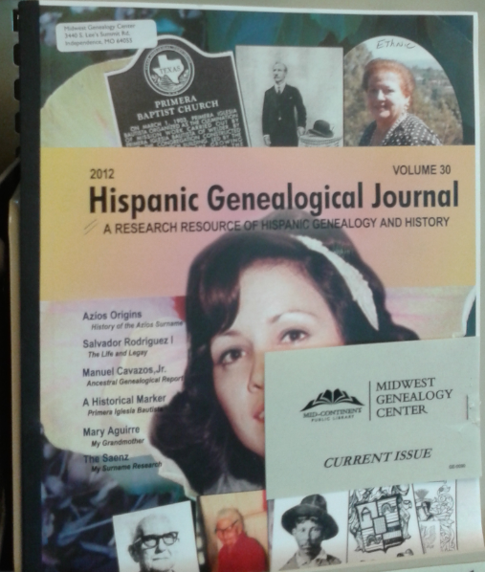
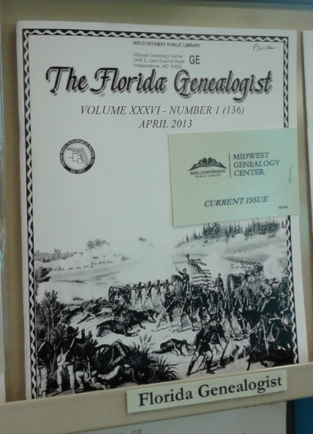
Periodicals
2,000 Genealogy Magazines
480 currently receiving issues
Focus can be geographic region, family, or event
Every Name or Place in Titles is indexed in PERSI; available through Heritage Quest (online)
Able to order copies not found here through inter-library loan. Nominal fee or free.

Slide 31

Classes
Multiple classes at MGC each month
Free; 45-60 minutes
Sign up online
Video classes available at www.midwestgenealogycenter.org
Do not need library card
Quarterly Access Guide available at MGC
previews upcoming classes

Slide 32
Midwest Genealogy Center
Thousands of records
Print, Film, Digital
National / International
Easily Accessible
Happy Researching!

Slide 33
Thank you!
beth@genealogydecoded.com
www.genealogydecoded.com

